Slide 1

IMLND
Deep learning

Slide 2
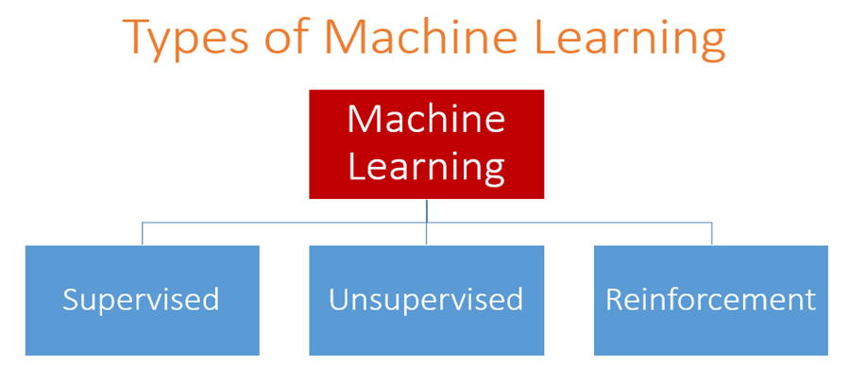
regression
classification
Clustering
perceptron

Slide 3
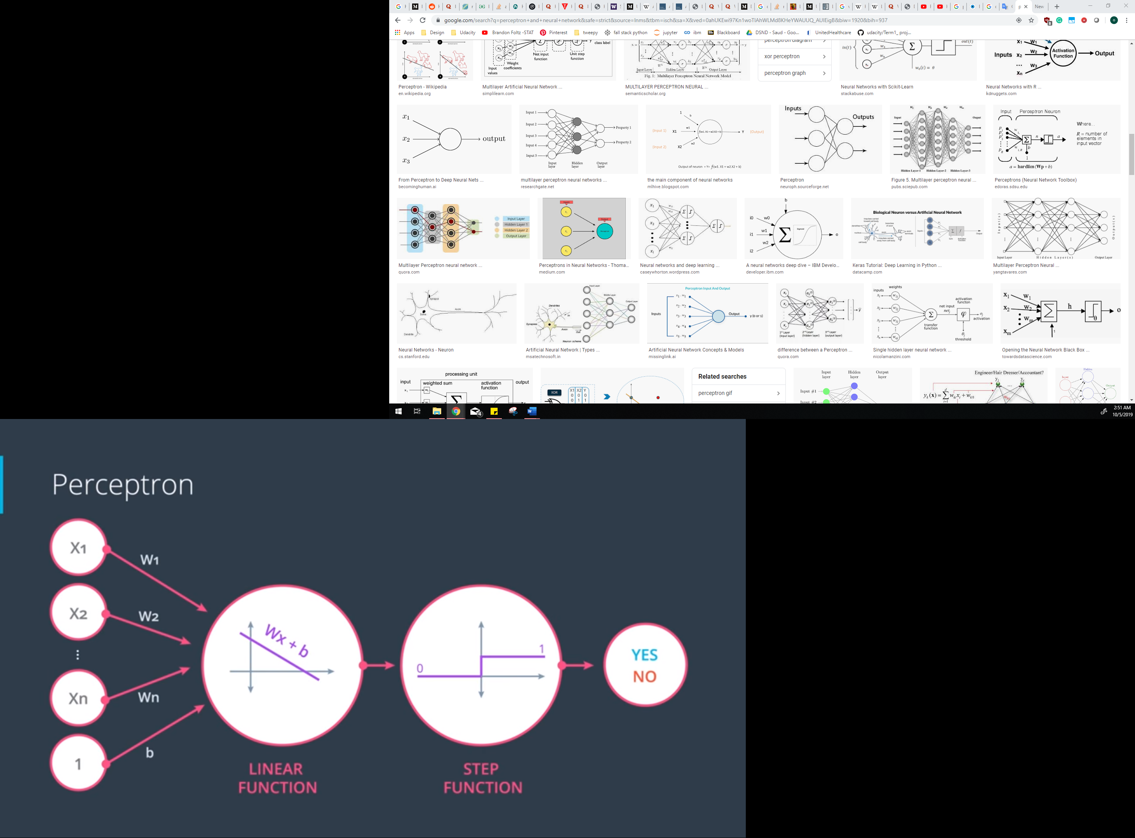
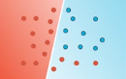
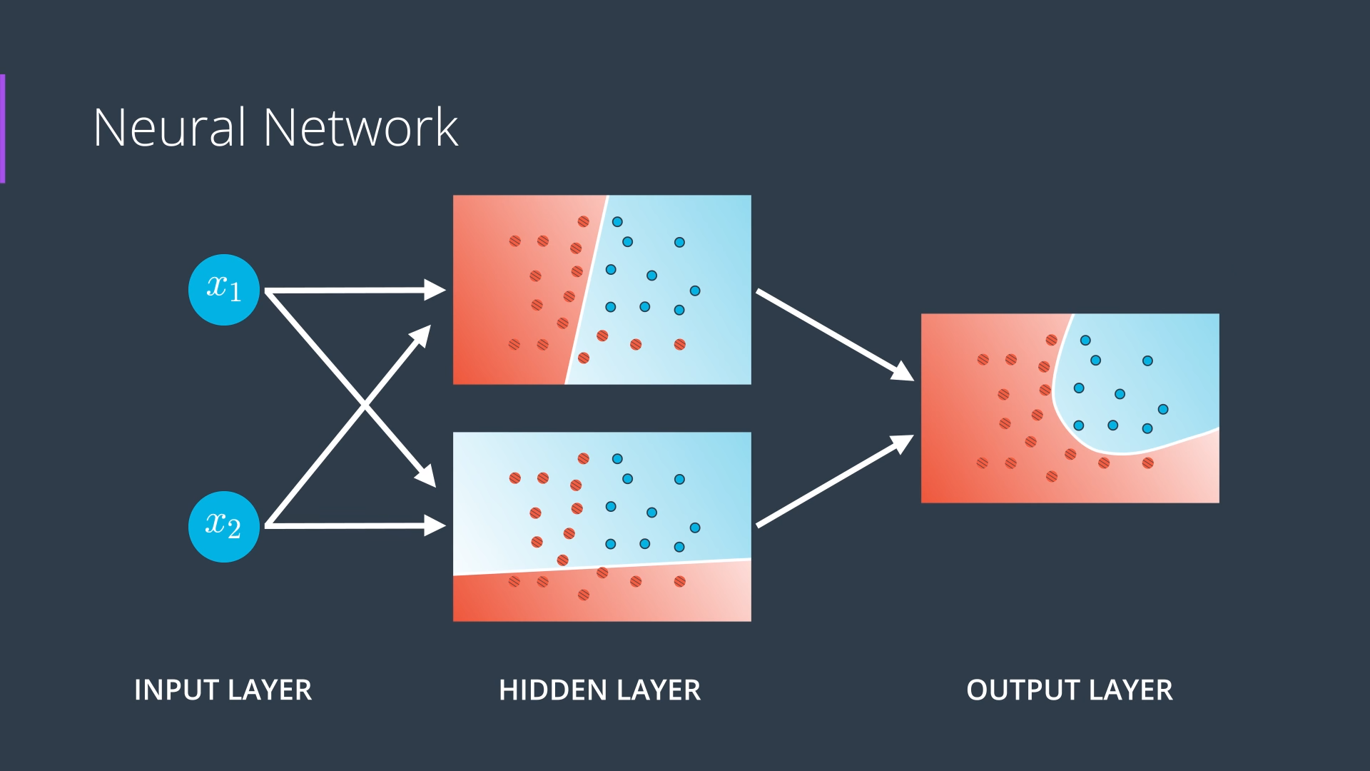

Slide 4
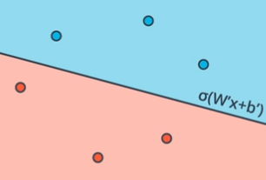
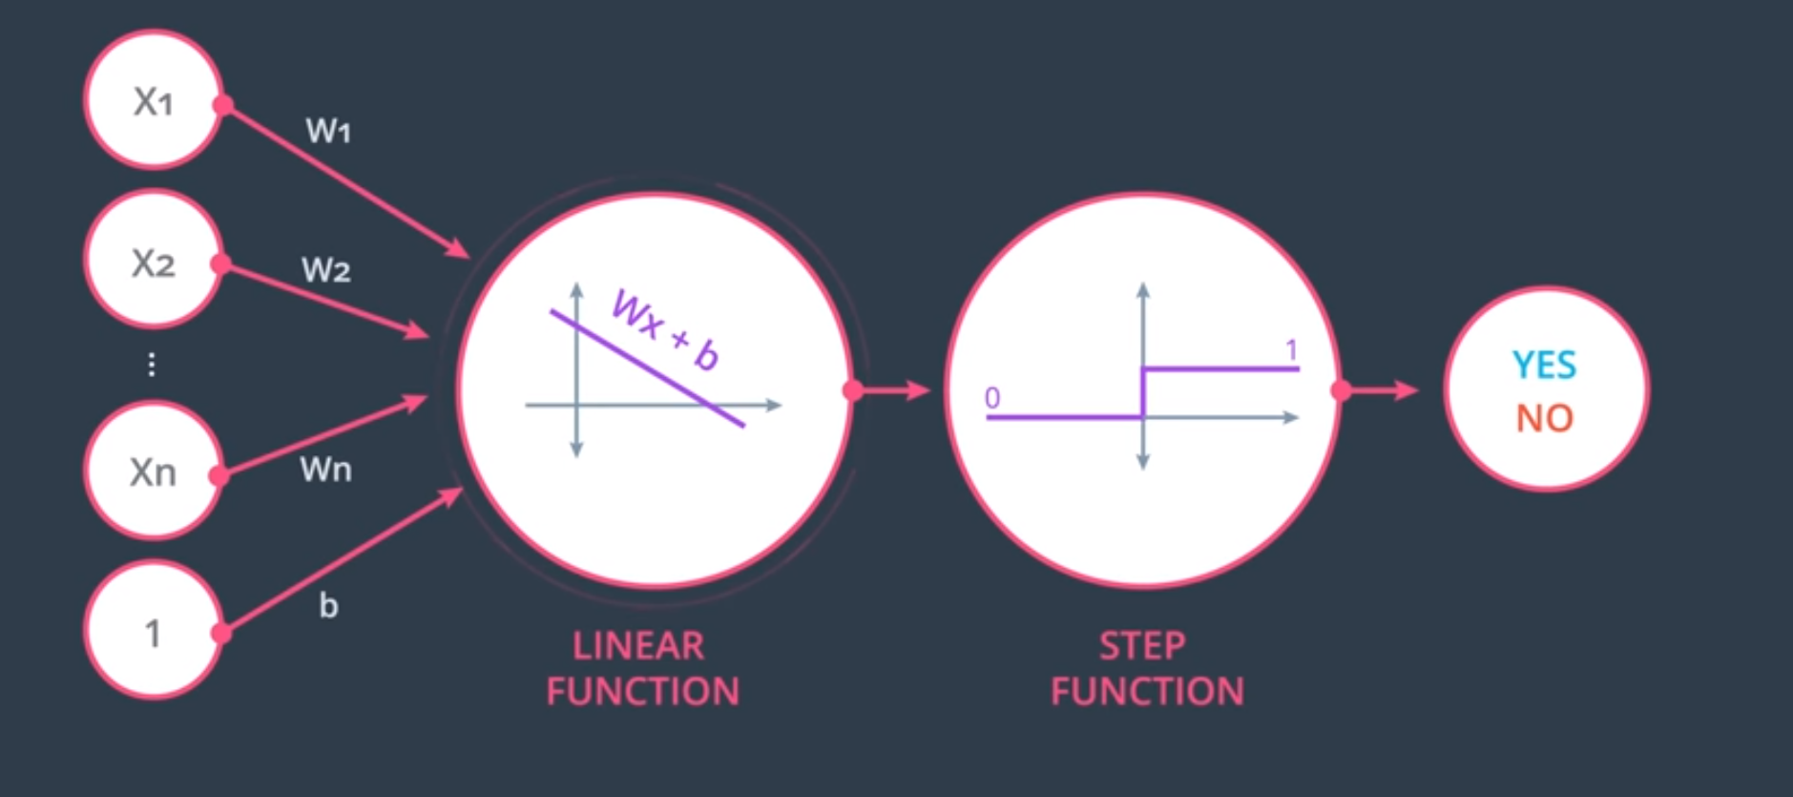
Activation function

Slide 6
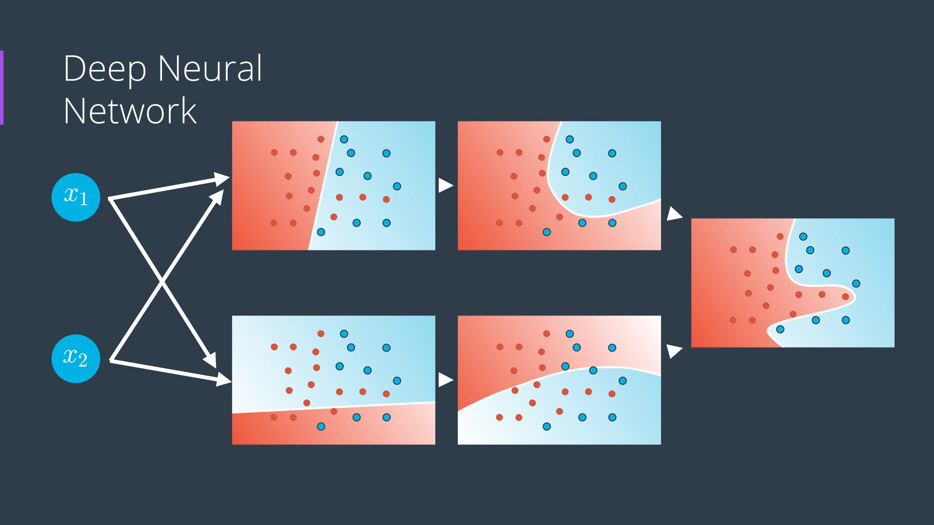
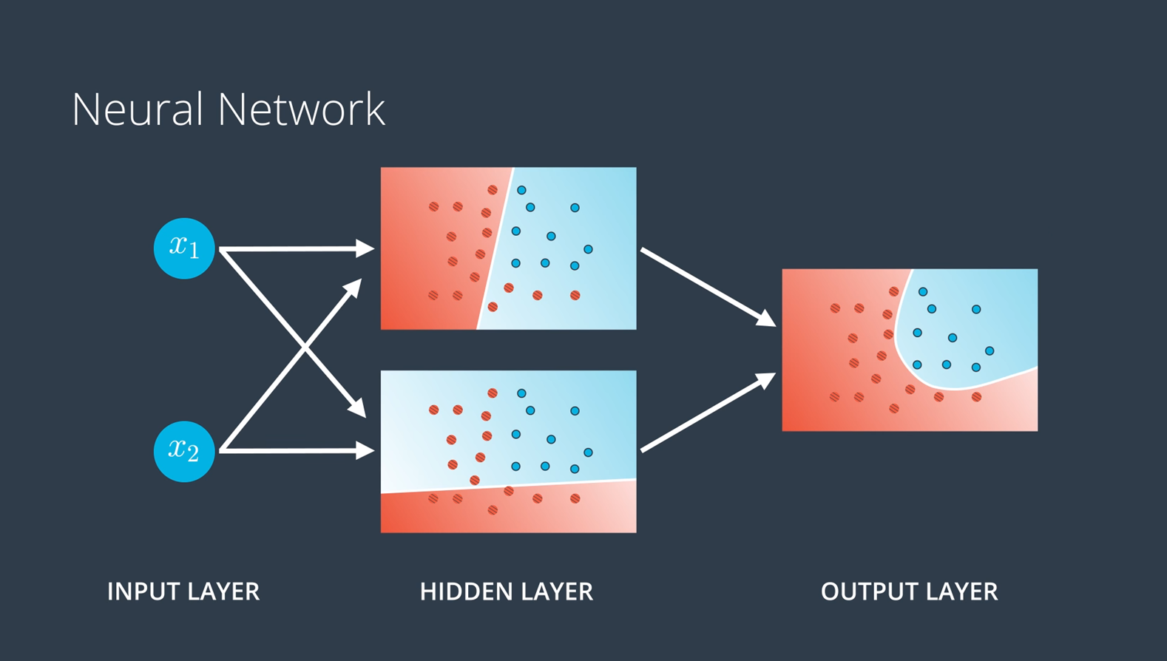

Slide 7
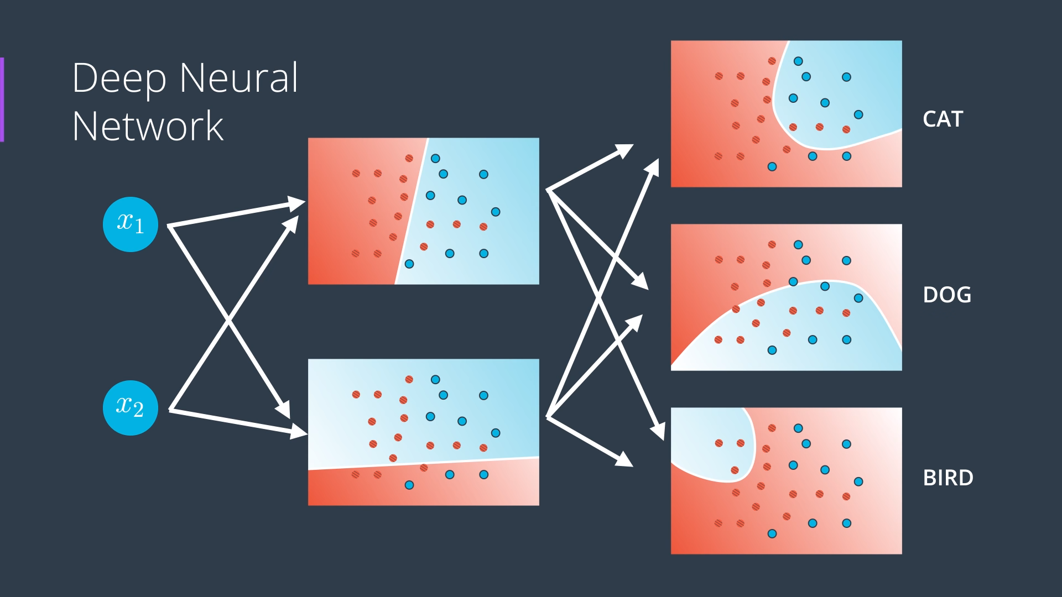

Slide 8
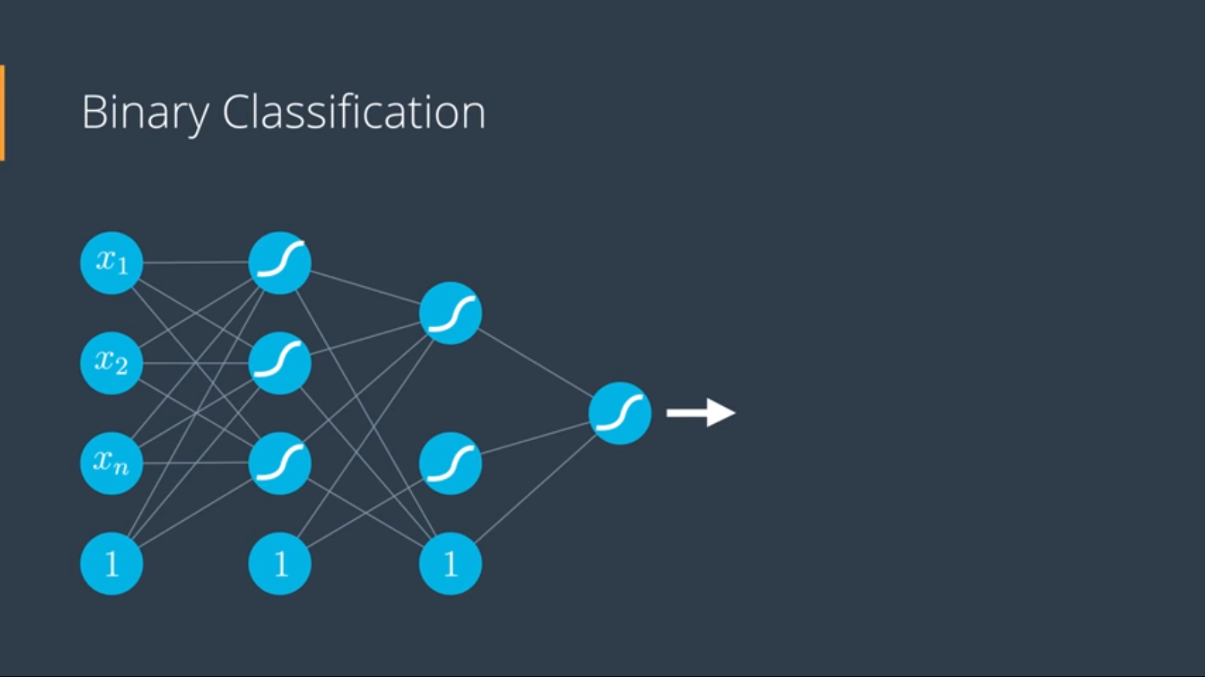
3

Slide 9
Model Training:
Process of training neural network:
FeedForward: build the equation of the model
Backpropogation: update the weights of the model

Slide 10
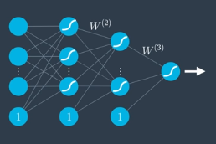
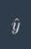
FeedForward
Backpropagation

Slide 11
Main Steps to build a model
Import libraries
Data gathering
Data cleaning
Data preprocessing
Define variables
Data splitting: to training, validation, and testing sets
Define model
Model Architecture: Input layer, hidden layer, output layer
Model parameters: loss function, activation function, learning rate, epoch…
Tune the model
Fit the model
Model prediction
Model accuracy

Slide 12
Deep learning limitations
Underfitting/ overfitting problem
BlackBox problem
Time processing problem

Slide 13
Deep learning applications:
Video games
Self-driving
Image recognition

Slide 14


